Slide 1

Survival Analysis of Glioma Patients Using Kaplan-Meier Estimation and Cox Regression
Antonios Martsekis
An Exploratory Study Using the Chinese Glioma Genome Atlas (CGGA)

Slide 2
Introduction
Background
Gliomas are heterogeneous brain tumors
Survival varies substantially across tumor grades
Survival data is censored and time-to-event
Motivation
Survival analysis is essential for clinical prognosis
Classical methods remain widely used and interpretable

Slide 3
Study Objectives
Main objective
Compare survival outcomes across WHO grades II, III, and IV
Secondary objectives
Assess the effect of age and gender on survival
Evaluate prognostic value using Cox regression

Slide 4
Dataset Description
Data source
Chinese Glioma Genome Atlas (CGGA)
Cohort
Adult glioma patients
WHO grades II–IV
Variables
Overall survival (days)
Event indicator
WHO grade
Age, Gender
Final sample: 280 patients, 182 events

Slide 5
Data Preparation
Preprocessing
Removed missing WHO grade or survival outcomes
Converted variables to numeric form
Gender recoded as binary
WHO grade treated as categorical (WHO II reference)
Missing data
Complete-case analysis adopted

Slide 6
Methods Overview
Analytical approach
Kaplan–Meier survival estimation
Log-rank tests
Cox proportional hazards regression
Within-grade Cox models
Model diagnostics
Concordance index (C-index)
Proportional hazards assumption (discussion)

Slide 7
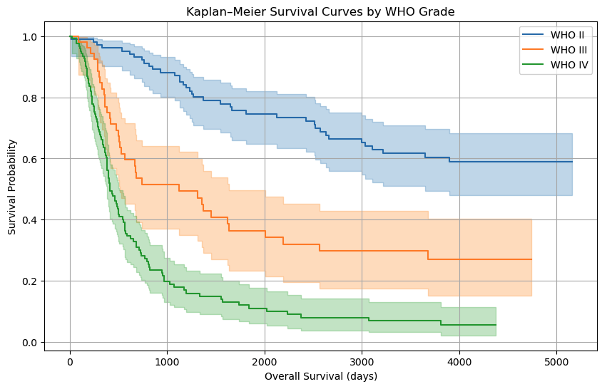
Kaplan-Meier Analysis by WHO Grade
Findings
Clear separation of survival curves
WHO II: best survival
WHO III: intermediate
WHO IV: poorest prognosis
Log-rank test
p < 0.001

Slide 8
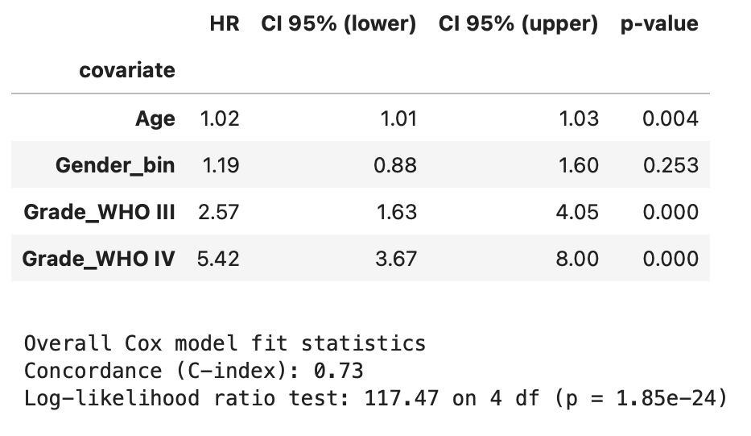
Cox Regression: Overall Model
Covariates
Age
Gender
WHO grade
Key results
Age: HR ≈ 1.02 p.y. (p = 0.004)
Gender: not significant
WHO III vs II: HR = 2.57
WHO IV vs II: HR = 5.42
Model performance
C-index = 0.73

Slide 9
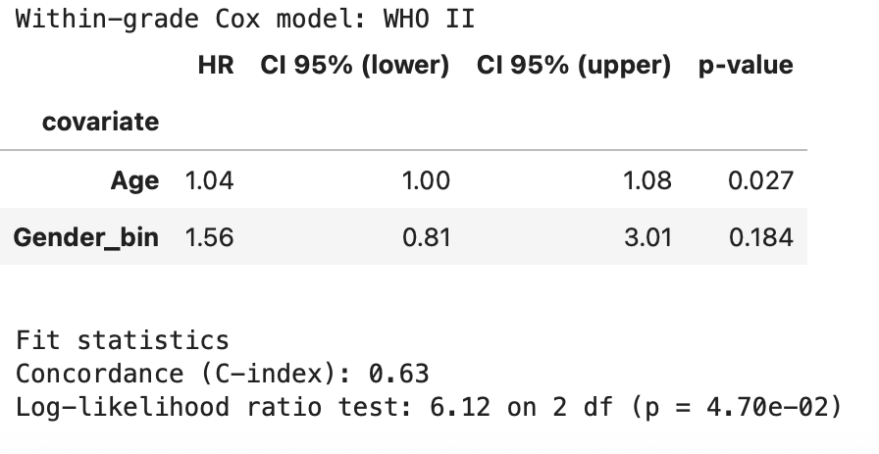
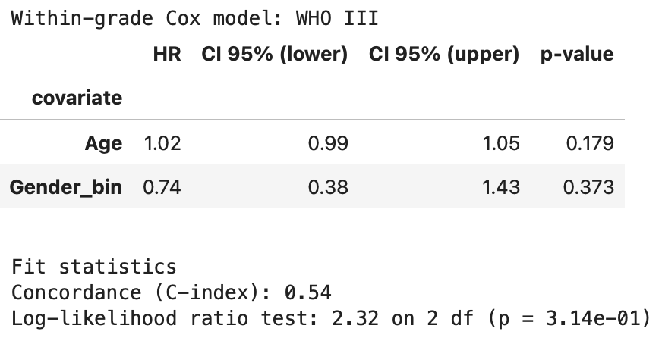
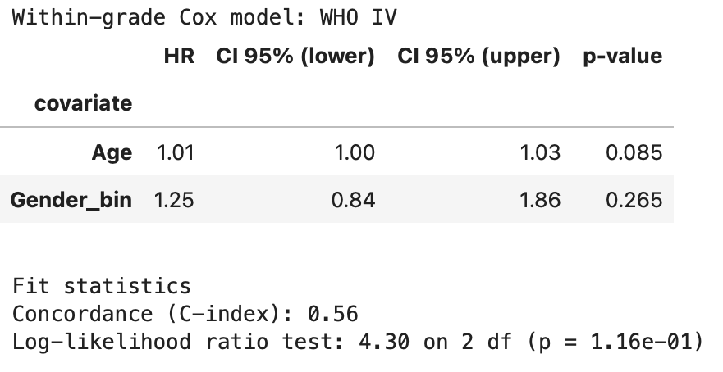
Within-Grade Cox Models
Purpose
Examine age and gender effects within each grade
Results
WHO II: age remains significant
WHO III & IV: no significant demographic effects
Lower C-index due to smaller sample sizes
Interpretation
High-grade survival driven mainly by tumour biology

Slide 10
Discussion
Key insights
WHO grade is the strongest prognostic factor
Age has a modest but consistent effect
Gender not independently associated with survival
Methodological agreement
Kaplan-Meier and Cox results are consistent

Slide 11
Limitations and Conclusion
Limitations
Missing molecular variables
Small WHO III subgroup
Complete-case analysis
Conclusion
WHO grade strongly stratifies survival
Classical survival models remain effective and interpretable

Slide 12
Thank you for your attention
and I welcome any questions!

